Slide 1

To cut or to fill: a global optimization approach to topological simplification
DAN ZENG ¹, ERIN CHAMBERS ², DAVID LETSCHER ², TAO JU ¹
¹ Washington University in St. Louis
² Saint Louis University

Slide 2
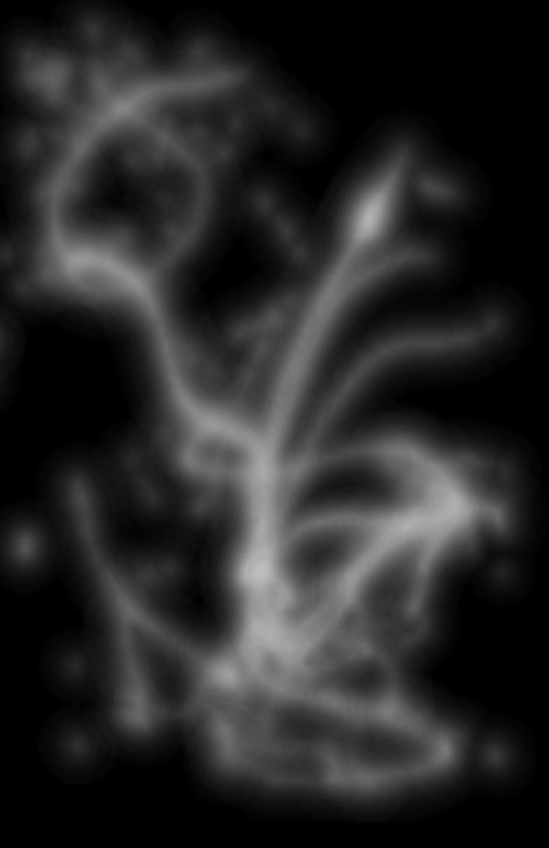
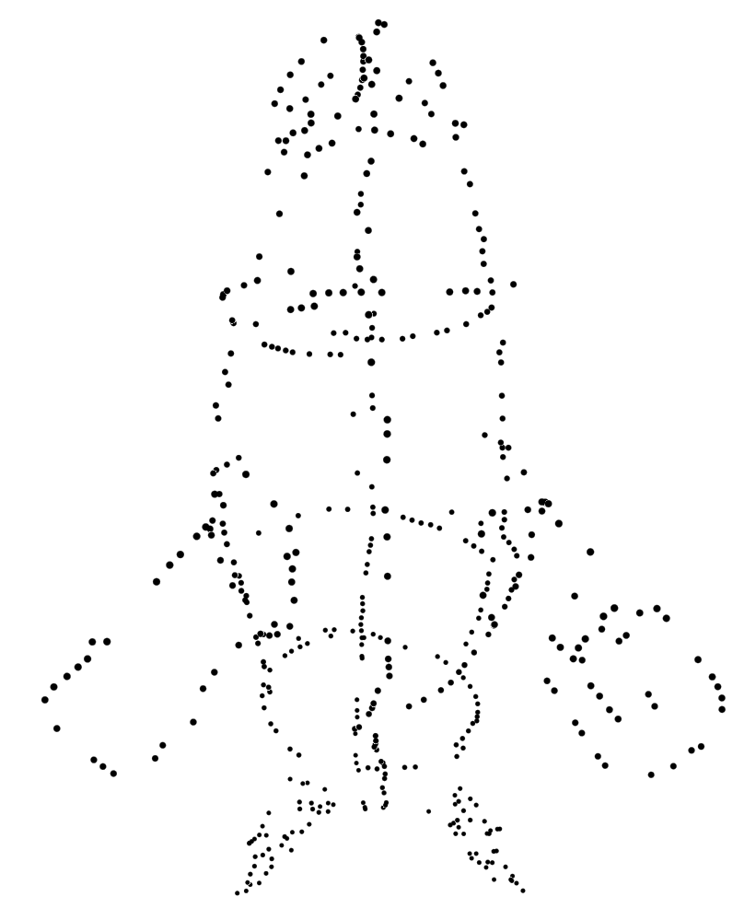
Motivation
CT Scan
Point cloud

Slide 3
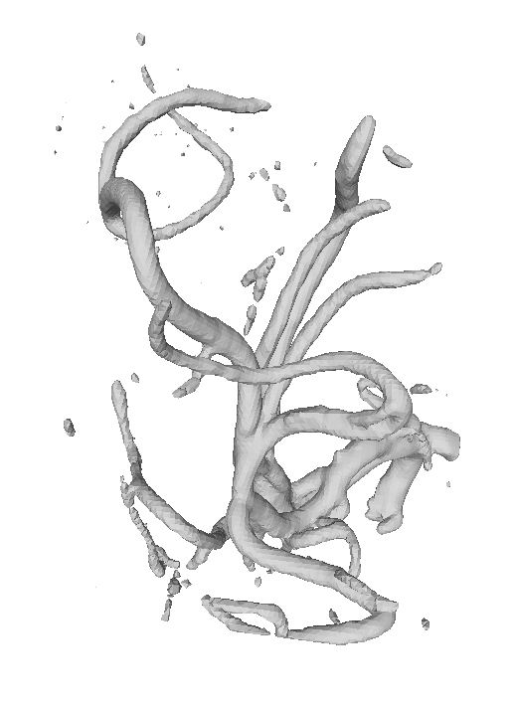
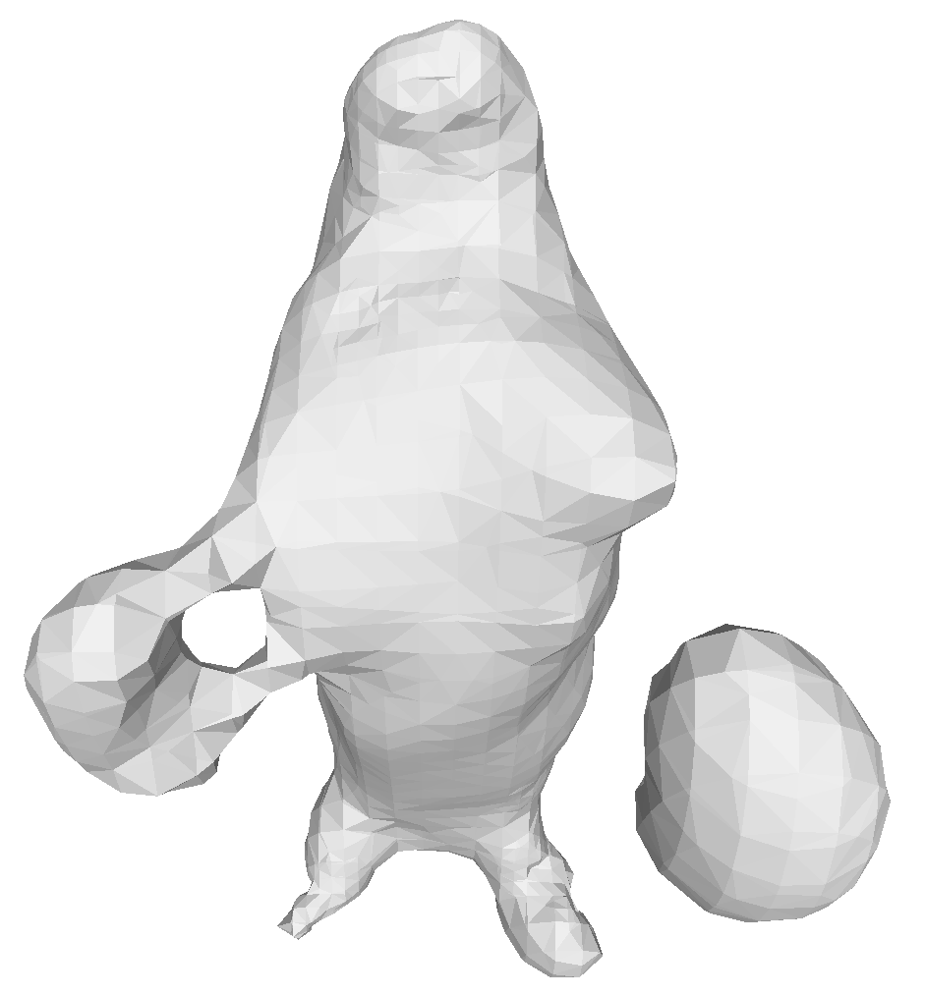
Motivation
CT Scan
(Iso-surface)
Point cloud
(Poisson Reconstruction)

Slide 4
Motivation
Connected Components
CT Scan
(Iso-surface)
Point cloud
(Poisson Reconstruction)

Slide 5
Motivation
Connected Components
Handles
CT Scan
(Iso-surface)
Point cloud
(Poisson Reconstruction)

Slide 6
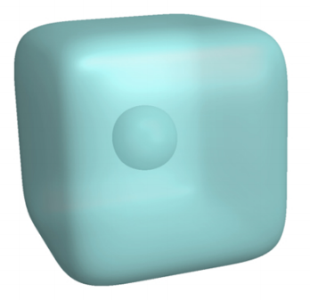
Motivation
Connected Components
Handles
Cavities
CT Scan
(Iso-surface)
Point cloud
(Poisson Reconstruction)

Slide 7
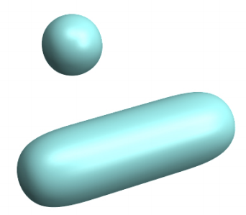
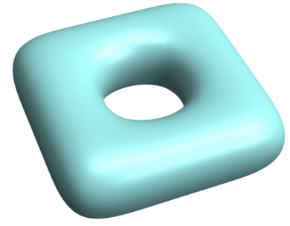
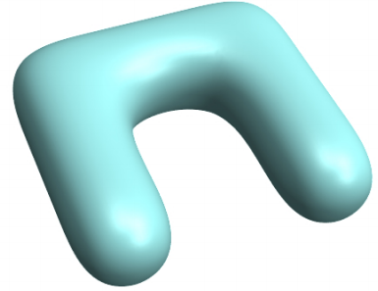
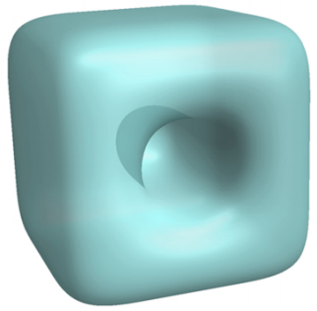
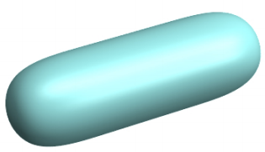
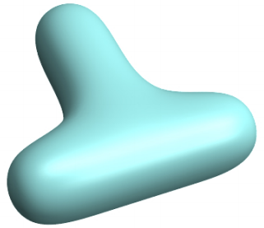
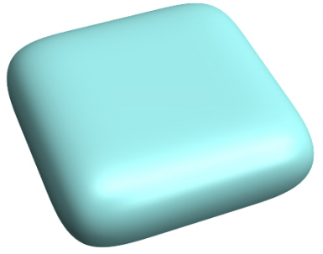
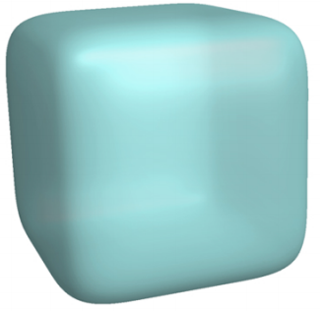
Cutting and Filling
Connected Components
Handle
Cavity
Cutting
Filling

Slide 8
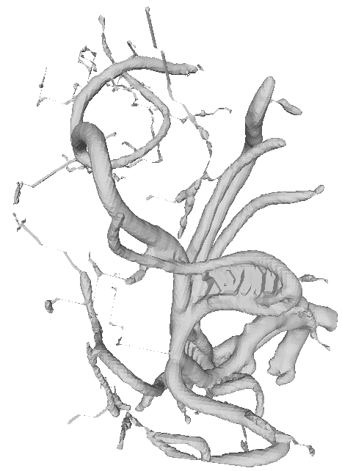
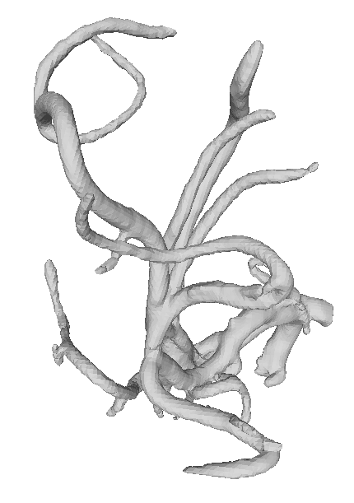
Related works
Monotonic methods: only cutting, or only filling
  [Chen et al. 2006], [Shattuck et al. 2001], [Han et al. 2002], [Zhou et al. 2007], [Nooruddin et al. 2003] [Bischoff et al. 2002], [Kriegeskorte et al. 2001], [Sczymzak et al. 2003], [Chambers et al. 2018]
  Result in very large geometric changes
Input
Monotonic
(filling only)
Monotonic
(cutting only)

Slide 9
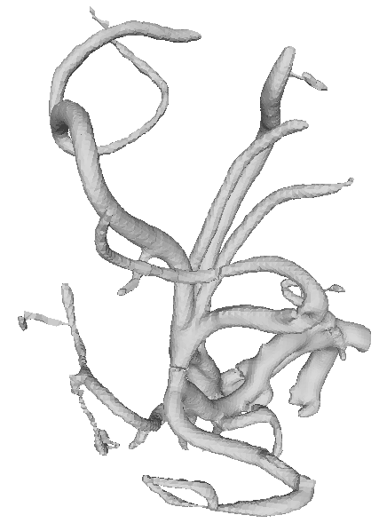
Related works
Non-Monotonic methods: both cutting and filling
  [Wood et al. 2004], [Kriegeskorte and Goebel 2001], [Ségonne et al. 2007], [Ju et al. 2007]
  Existing methods apply greedy heuristics and can still result in excessive changes
Input
Monotonic
(filling only)
Monotonic
(cutting only)
Non-monotonic

Slide 10
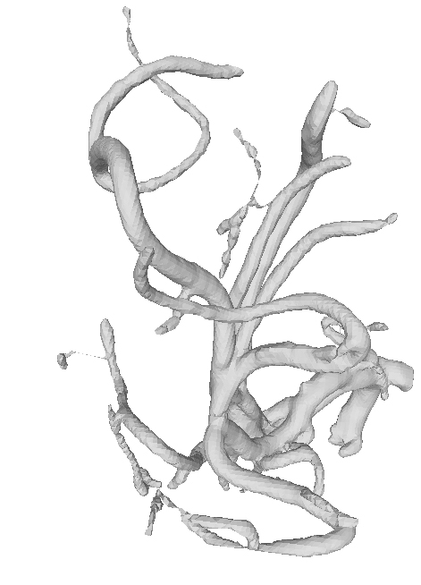
Contributions
A non-monotonic algorithm
  Attempts to find the globally optimal set of cuts and fills that maximally simplifies topology while minimizing geometric changes
Input
Monotonic
(filling only)
Monotonic
(cutting only)
Non-monotonic
Ours

Slide 11
Input
Shape represented as a cell complex
  2D: pixels, triangles, etc.
  3D: voxels, tetrahedra, etc.
Cuts
Cuts and fills
  Cells to be removed or added to the shape
Each cut or fill cell is associated with a
geometric cost
Can be obtained using existing monotonic
simplification methods
Fills

Slide 12
Goal
Find a subset of the cuts and fills that
  Minimizes the total number of topological features (1st priority)
  Minimizes the total geometric cost (2nd priority)
1
20
1
15
Input
Only cutting
Only filling
Optimal
# components:
2
1
1
1
# cavities:
1
0
0
0
# geometric cost:
0
16
21
2

Slide 13












Graph formulation
Representing partitioning of space into regions of different types
Cut and fill nodes: connected components of cuts and fills
Kernel nodes: connected components of shape minus cuts
Neighborhood nodes: connected components of background minus fills
$$c2$$
$$n1$$
$$k1$$
$$f2$$
$$c1$$
$$f1$$
$$f1$$
$$c1$$
$$c2$$
$$f2$$
$$k1$$
$$n1$$

Slide 14












Graph formulation
1/0 labelling of nodes represents selection of cuts and fills
  1-labelled fill nodes and 0-labelled cut nodes are selected
  Kernel nodes are labelled 1, neighborhood nodes labelled 0
$$c2$$
$$n1$$
$$k1$$
1-labelled
$$f2$$
$$c1$$
$$f1$$
0-labelled
$$f1$$
$$c1$$
$$c2$$
$$f2$$
$$k1$$
$$n1$$

Slide 15
Graph formulation
A node-wise cost is defined for each cut or fill node
  Obtained from the Euler characteristic and geometric cost of the node
$$c2$$
$$n1$$
$$k1$$
1-labelled
$$f2$$
$$c1$$
$$f1$$
0-labelled
$$f1$$
$$c1$$
$$c2$$
$$f2$$
$$k1$$
$$n1$$

Slide 16
Graph formulation
Problem: Find a 1/0 labelling that minimizes the sum of:
  Number of connected components of the 1-labelled and 0-labelled subgraphs
  Total labelling costs of all nodes
$$k1$$
1-labelled
$$c1$$
$$f1$$
0-labelled
# 1-labelled components: 1
# 0-labelled components: 1
$$c2$$
$$f2$$
$$n1$$

Slide 17
Graph Labelling
Treat connectivity as constraints, instead of an energy term
Constrain both 0/1-labelled subgraphs to be as connected as possible
  Solve the connectivity-constrained labelling problem using Steiner Tree

Slide 18
Graph Labelling
Reachable sets
  A set of kernel (resp. neighborhood) nodes that are connected when all cut and fill nodes are labelled 1 (resp. 0).

Slide 19







Graph Labelling
Reachable sets
  A set of kernel (resp. neighborhood) nodes that are connected when all cut and fill nodes are labelled 1 (resp. 0).
$$k1$$
$$k2$$
$$k3$$
$$c1$$
$$f1$$
$$n1$$
$$n2$$
{ k1, k2 } and { k3 } are reachable sets

Slide 20







Graph Labelling
Reachable sets
  A set of kernel (resp. neighborhood) nodes that are connected when all cut and fill nodes are labelled 1 (resp. 0).
$$k1$$
$$k2$$
$$k3$$
$$k1$$
$$k2$$
$$k3$$
$$c1$$
$$f1$$
$$c1$$
$$f1$$
$$n1$$
$$n2$$
$$n1$$
$$n2$$
{ k1, k2 } and { k3 } are reachable sets
{n1, n2} are in reachable set

Slide 21
Graph Labelling
Reachable sets
  A set of kernel (resp. neighborhood) nodes that are connected when all cut and fill nodes are labelled 1 (resp. 0).
  Such that any reachable set of kernel (resp. neighborhood) nodes are connected in the 1(resp. 0)-labelled subgraph
$$k1$$
$$k2$$
$$k3$$
$$k1$$
$$k2$$
$$k3$$
$$c1$$
$$f1$$
$$c1$$
$$f1$$
$$n1$$
$$n2$$
$$n1$$
$$n2$$
{ k1, k2 } and { k3 } are reachable sets
{n1, n2} are in reachable set

Slide 22
Graph Labelling
As-connected-as-possible (ACAP) labelling
  Minimizes the total labelling cost
  Such that any reachable set of kernel (resp. neighborhood) nodes are connected in the 1(resp. 0)-labelled subgraph

Slide 23






Graph Labelling
As-connected-as-possible (ACAP) labelling
  Minimizes the total labelling cost
  Such that any reachable set of kernel (resp. neighborhood) nodes are connected in the 1(resp. 0)-labelled subgraph
$$k1$$
$$k2$$
$$f1$$
$$c1$$
$$f2$$
$$n1$$
ACAP

Slide 24
Graph Labelling
As-connected-as-possible (ACAP) labelling
  Minimizes the total labelling cost
  Such that any reachable set of kernel (resp. neighborhood) nodes are connected in the 1(resp. 0)-labelled subgraph
$$k1$$
$$k2$$
$$k1$$
$$k2$$
$$f1$$
$$f1$$
$$c1$$
$$c1$$
$$f2$$
$$f2$$
$$n1$$
$$n1$$
ACAP
Not ACAP

Slide 25












Graph Labelling
ACAP labelling as Node-Weighted Steiner Tree (NWST) problem
  Solution of ACAP labelling, if exists, can be found by NWST on an augmented graph
Augmented Graph (see paper for details)
$$k1$$
$$k2$$
$$k1$$
$$k2$$
$$c1$$
$$c1,f1$$
$$c1,f2$$
$$c1,f1,f2$$
$$f1$$
$$c1$$
$$c1$$
$$f1$$
$$f2$$
$$π$$
$$f2$$
$$f1$$
$$f2$$
$$c1,f1,f2$$
$$n1$$
$$n1$$

Slide 26





Graph Labelling
ACAP labelling may not have a solution
  An example is a double-articulation node
$$k1$$
$$k2$$
$$c1$$
$$n1$$
$$n2$$

Slide 27
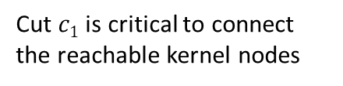
Graph Labelling
ACAP labelling may not have a solution
  An example is a double-articulation node
Cut $c1$ is critical to connect the reachable kernel nodes
$$k1$$
$$k2$$
$$c1$$
$$n1$$
$$n2$$

Slide 28





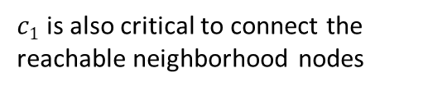
Graph Labelling
ACAP labelling may not have a solution
  An example is a double-articulation node
Cut $c1$ is critical to connect the reachable kernel nodes
$c1$ is also critical to connect the reachable neighborhood nodes
$$k1$$
$$k2$$
$$k1$$
$$k2$$
$$c1$$
$$c1$$
$$n1$$
$$n2$$
$$n1$$
$$n2$$

Slide 29
Graph Labelling
ACAP labelling may not have a solution
  An example is a double-articulation node
  NWST would return a conflicting label of a cut/fill node
Cut $c1$ is critical to connect the reachable kernel nodes
$c1$ is also critical to connect the reachable neighborhood nodes
$$k1$$
$$k2$$
$$k1$$
$$k2$$
$$c1$$
$$c1$$
$$n1$$
$$n2$$
$$n1$$
$$n2$$

Slide 30









Graph Labelling
Iterative labelling
$$k1$$
$$k2$$
$$k3$$
$$c1$$
$$f1$$
$$c2$$
$$f2$$
$$n1$$
$$n2$$

Slide 31
Graph Labelling
Iterative labelling
  Greedily label double-articulation nodes
$$k1$$
$$k2$$
$$k3$$
$$c1$$
$$f1$$
$$c2$$
$$f2$$
Double articulation node
$$n1$$
$$n2$$

Slide 32
Graph Labelling
Iterative labelling
  Greedily label double-articulation nodes
$$k1$$
$$k2$$
$$k3$$
$$c1$$
$$f1$$
$$c2$$
$$f2$$
Double articulation node
$$n1$$
$$n2$$

Slide 33

Graph Labelling
Iterative labelling
  Greedily label double-articulation nodes
  Solve ACAP labelling (via NWST)
$k1$ ,$c1,k2$
$$k3$$
$$f1$$
$$c2$$
$$f2$$
$$n1$$
$$n2$$

Slide 34
Graph Labelling
Iterative labelling
  Greedily label double-articulation nodes
  Solve ACAP labelling (via NWST)
$k1$ ,$c1,k2$
$$k3$$
$$f1$$
$$c2$$
$$f2$$
$$n1$$
$$n2$$

Slide 35
Graph Labelling
Iterative labelling
  Greedily label double-articulation nodes
  Solve ACAP labelling (via NWST)
  Return the solution if no node has conflicting labels; otherwise greedily label such node, and repeat
$k1$ ,$c1,k2$
$$k3$$
$$f1$$
$$c2$$
$$f2$$
$$n1$$
$$n2$$

Slide 36
Results
Input shapes represented as voxels
Cuts and fills computed by two different (monotonic) methods:

Slide 37
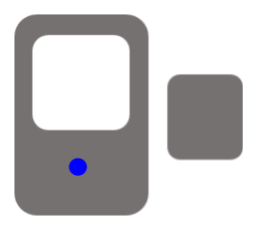
Results
Input shapes represented as voxels
Cuts and fills computed by two different (monotonic) methods:
Inflation/deflation

Slide 38

Results
Input shapes represented as voxels
Cuts and fills computed by two different (monotonic) methods:
Inflation/deflation

Slide 39

Results
Input shapes represented as voxels
Cuts and fills computed by two different (monotonic) methods:
Inflation/deflation

Slide 40

Results
Input shapes represented as voxels
Cuts and fills computed by two different (monotonic) methods:
Inflation/deflation

Slide 41
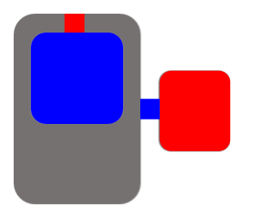
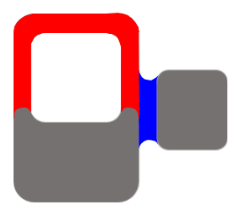
Results
Input shapes represented as voxels
Cuts and fills computed by two different (monotonic) methods:
Inflation/deflation
Opening/closing

Slide 42
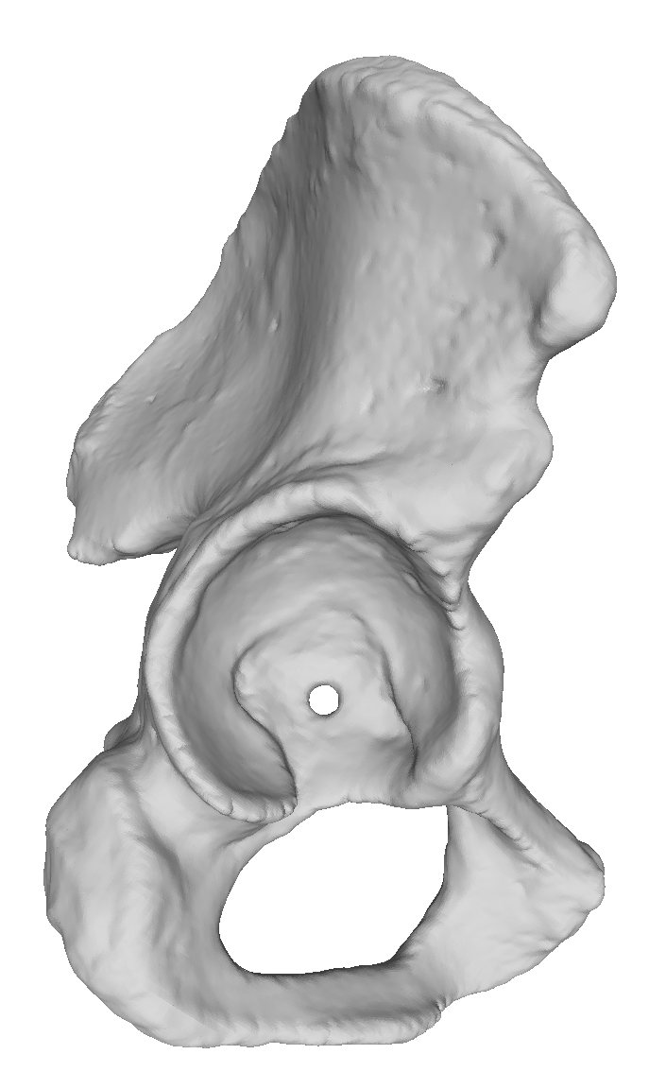
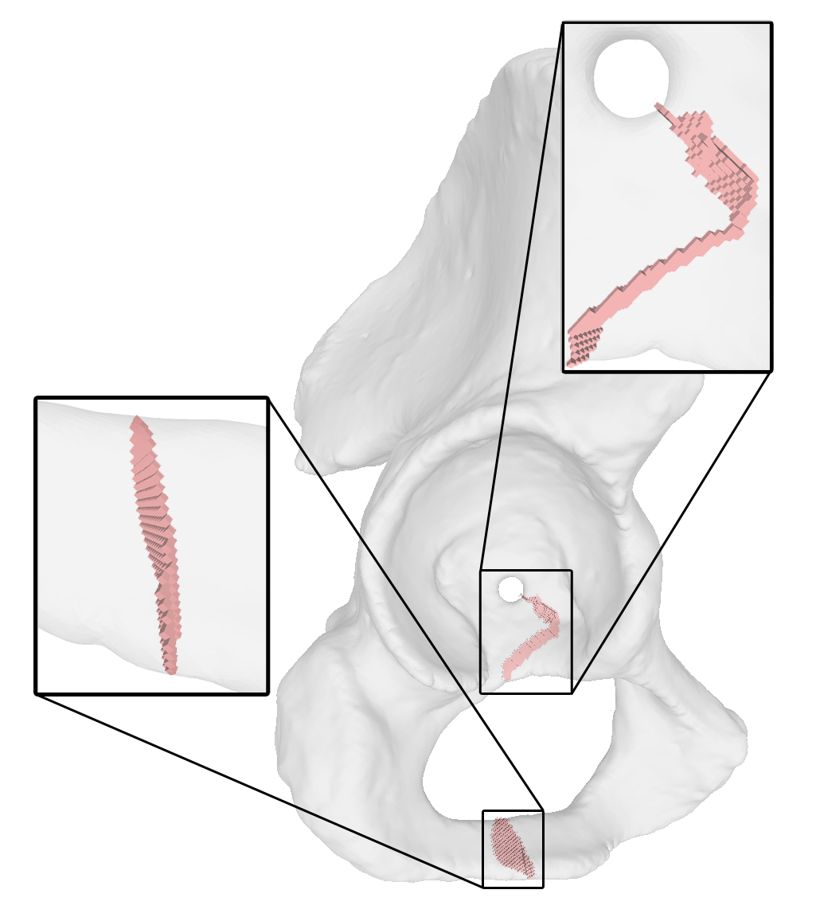
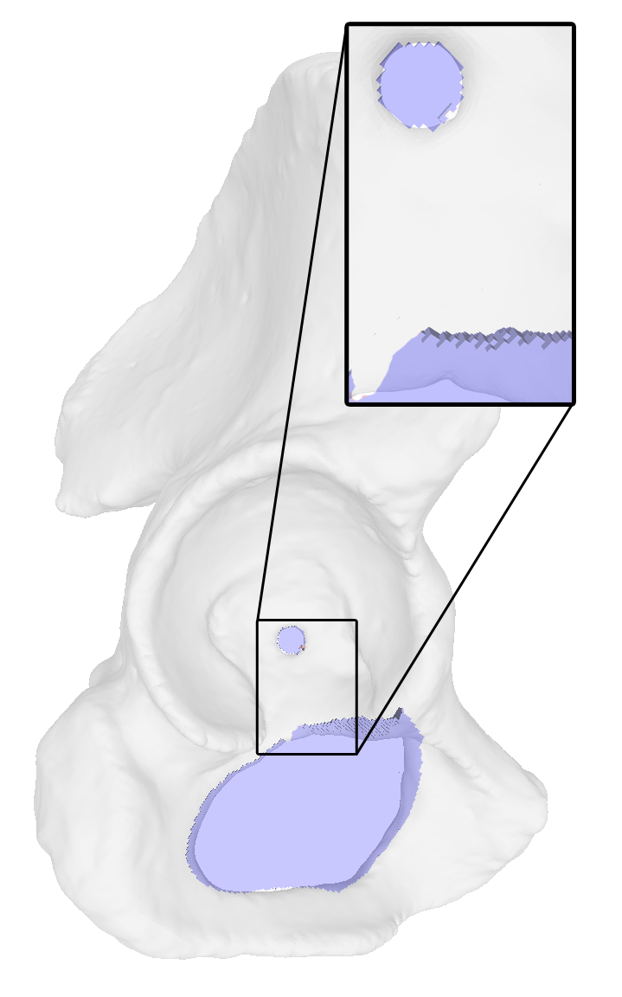
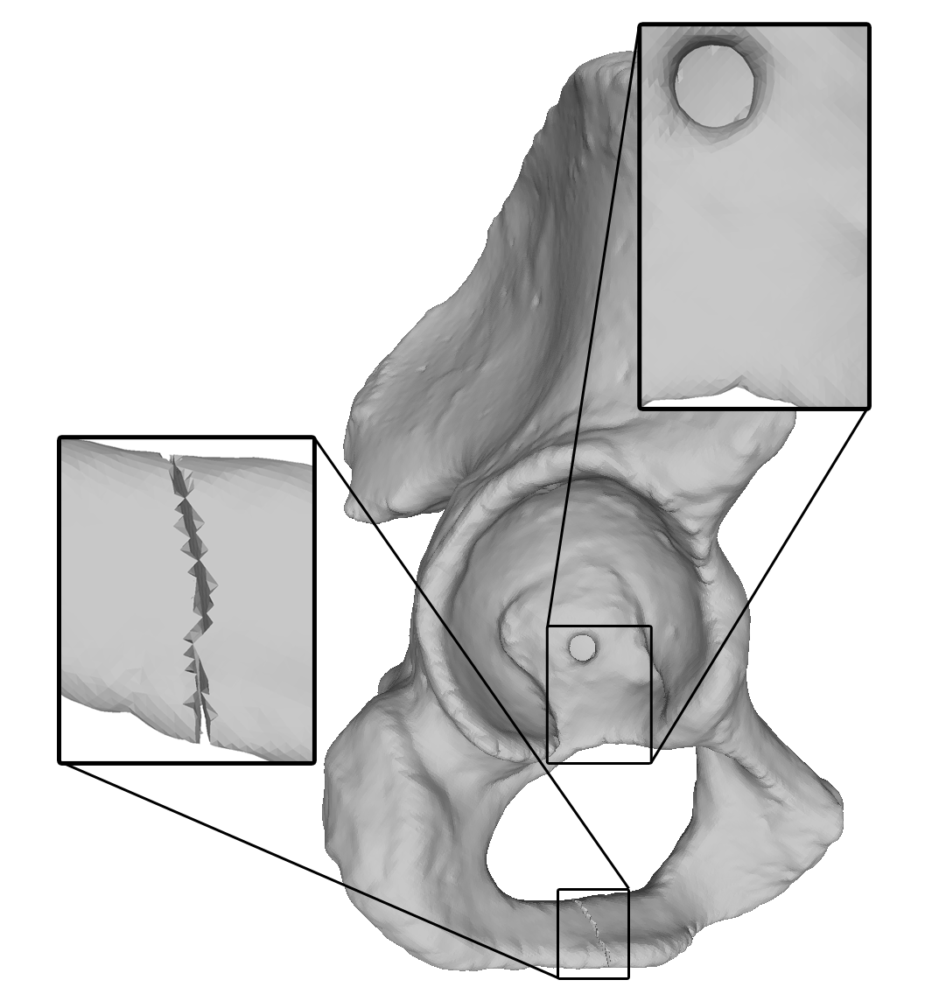
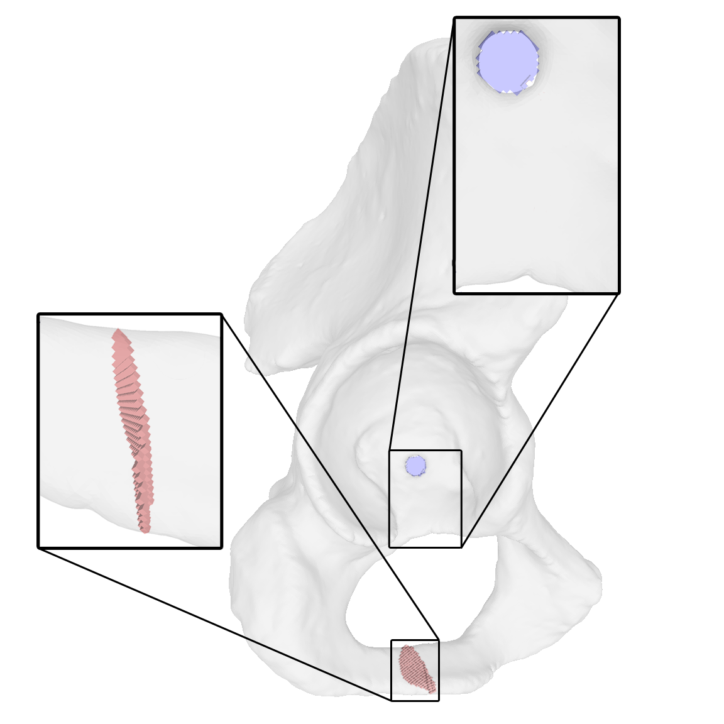
Results
Hip model (inflation/deflation cuts and fills)
Input
Only Cutting
Only Filling
Ours
Components:
1
1
1
1
Handles:
2
0
0
0
Cavities:
0
0
0
0
Geometric cost:
0
756
6591
397

Slide 43
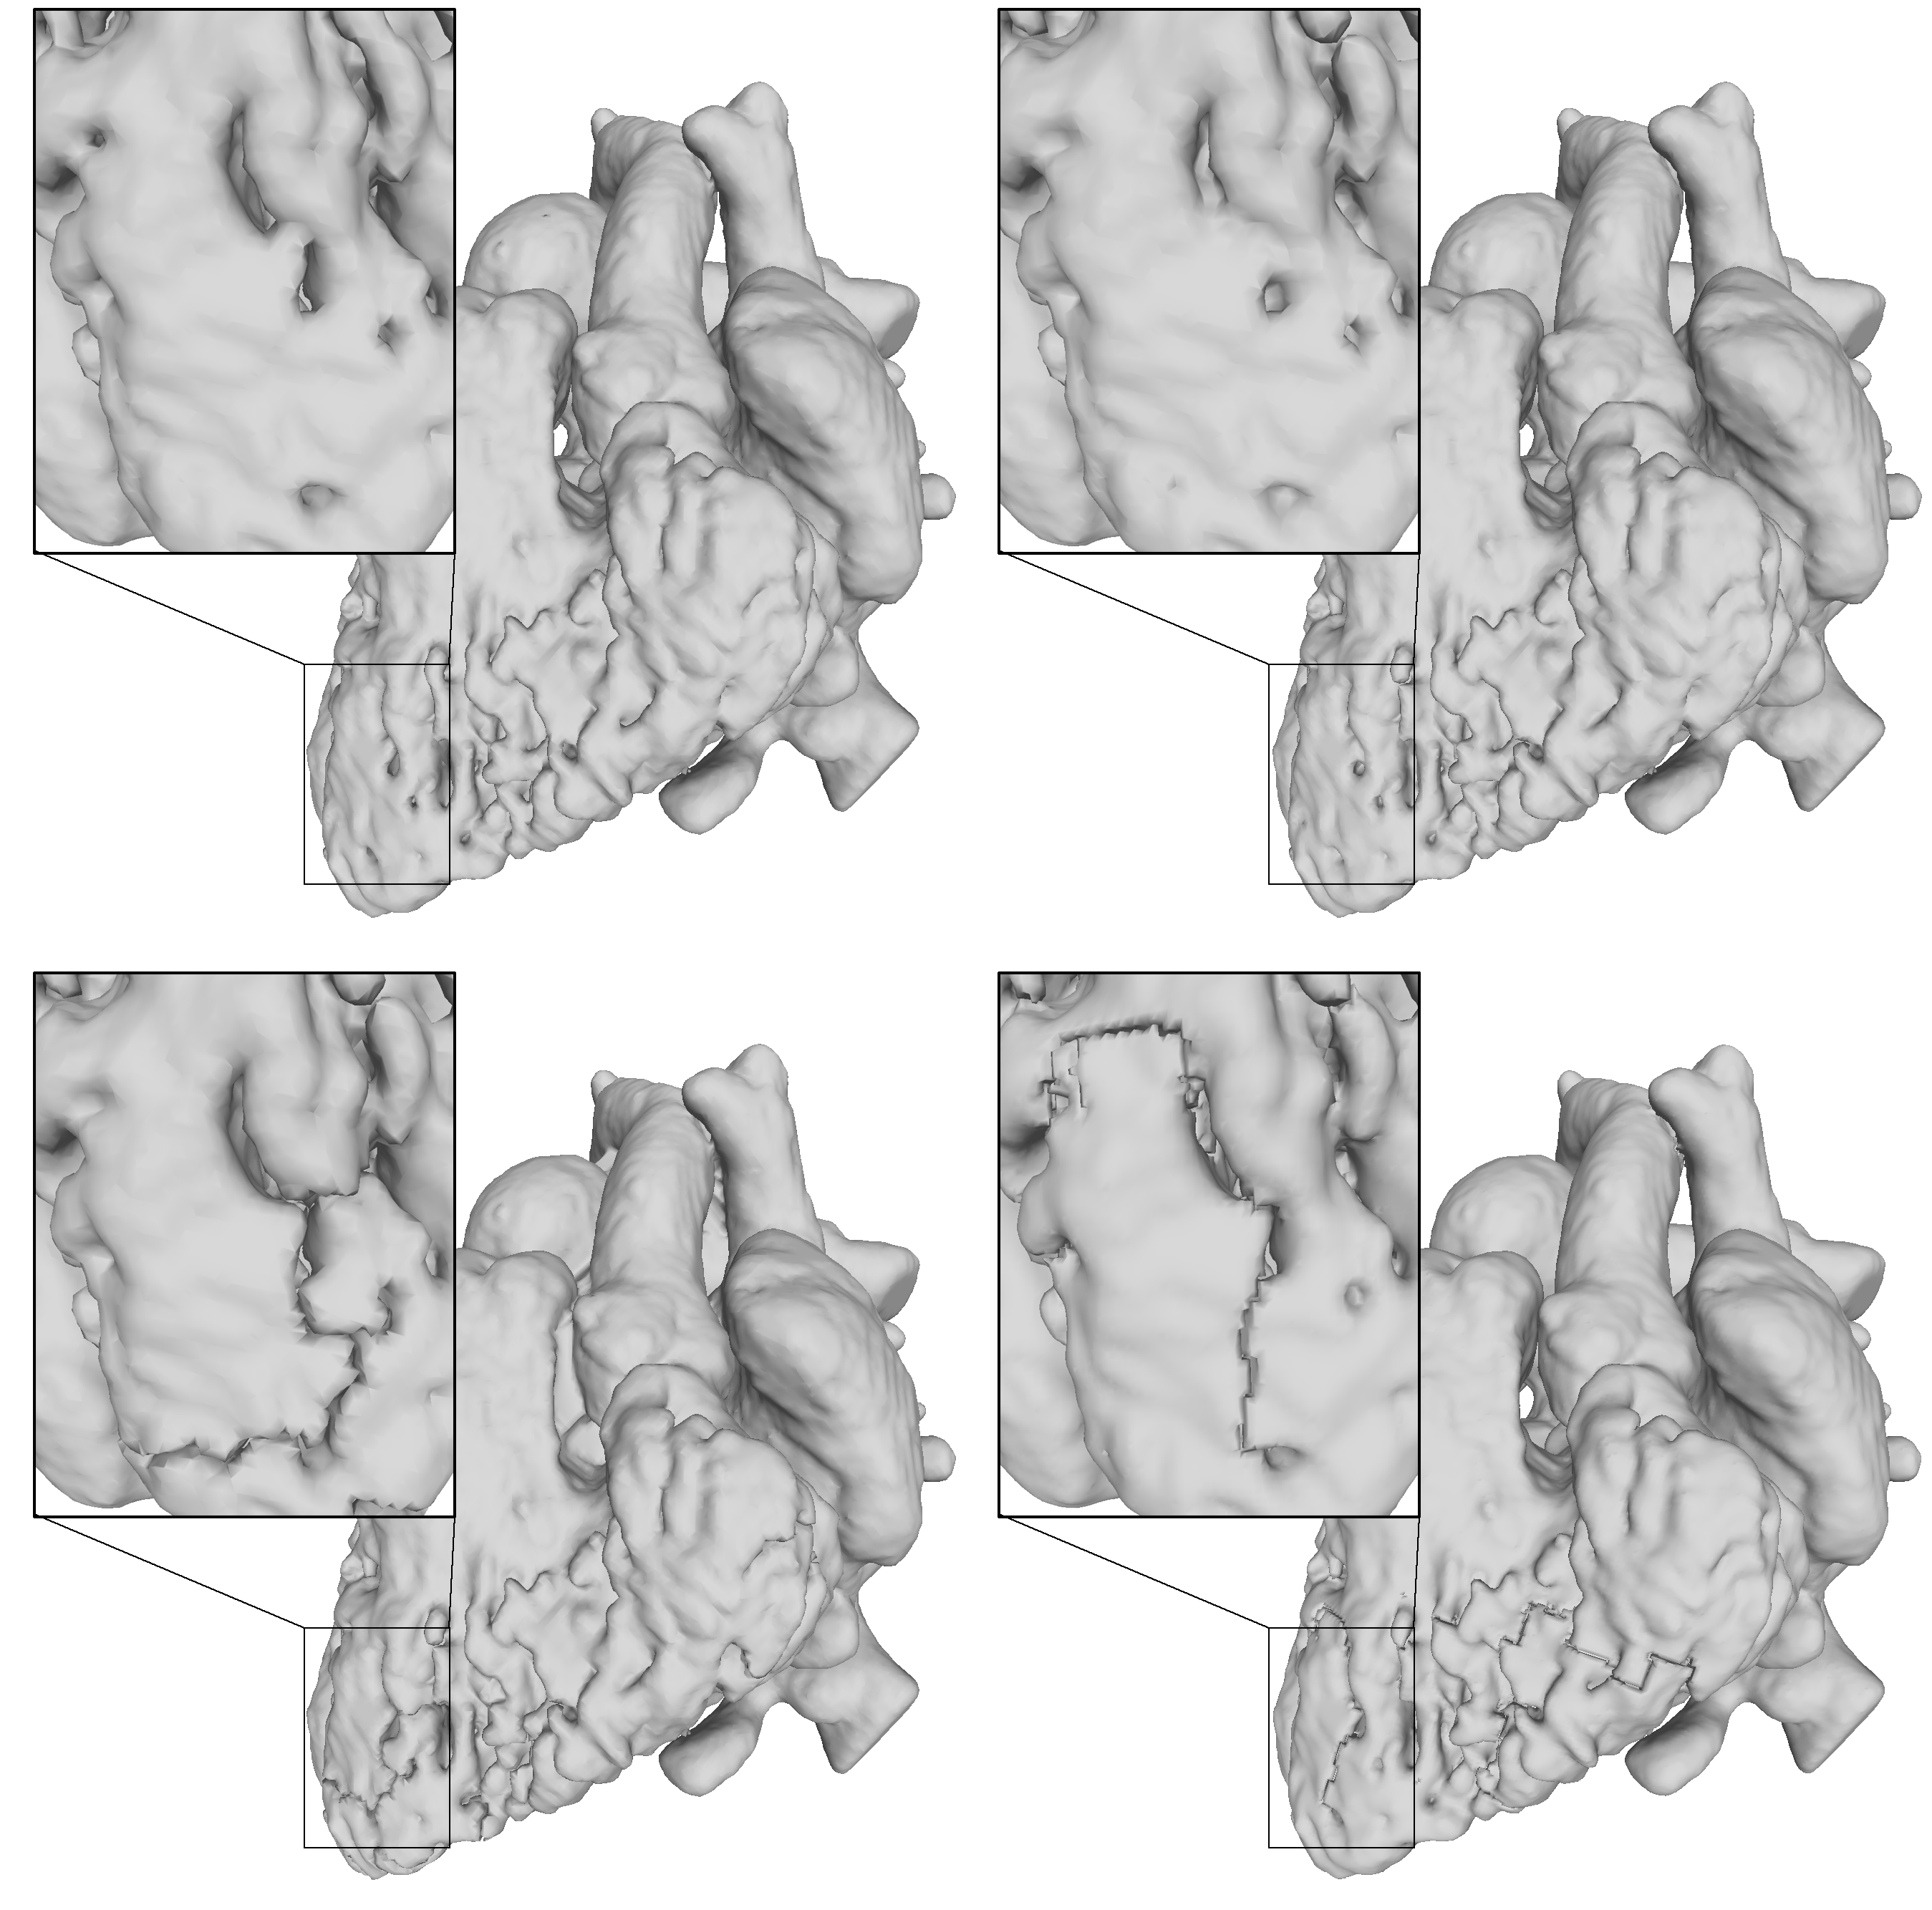
Results
Heart CT Scan (inflation/deflation cuts and fills)
Input
Greedy
[Ju 07]
Ours
Handle
body
Handles
Components:
2
1
1
1
Handles:
215
4
0
0
Cavities:
13
0
0
0
Geometric cost:
0
2738
N/A
902

Slide 44
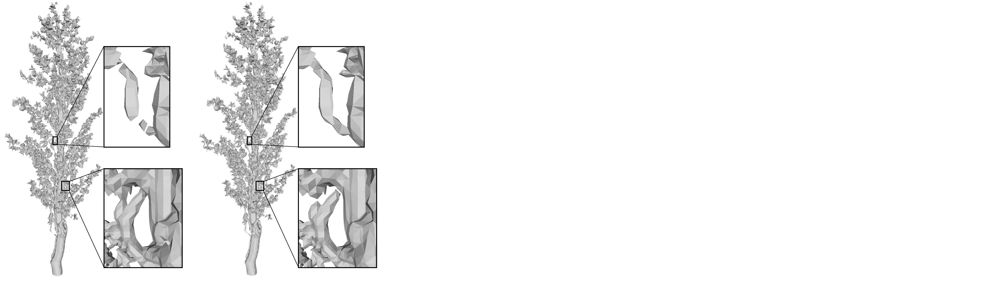
Results
Sorghum Panicle CT Scan (inflation/deflation cuts and fills)
Input
Ours
Timing
5.5 s
Lower bound
Components:
1749
22
20
Handles:
871
16
10
Cavities:
1
0
0

Slide 45
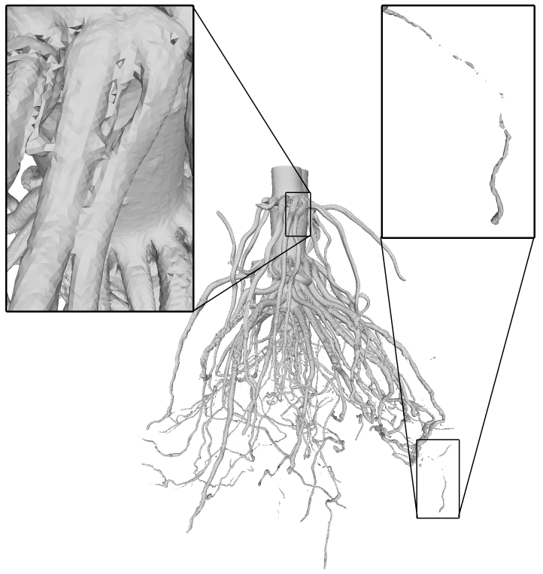
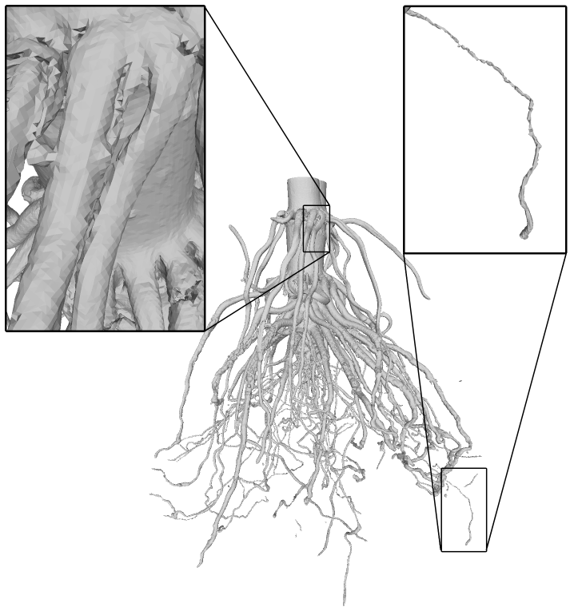
Results
Corn root CT Scan (inflation/deflation cuts and fills)
Input
Ours
Timing
35.1 s
Lower bound
Components:
1958
32
32
Handles:
2117
3
0
Cavities:
158
0
0

Slide 46
Conclusion
Summary: a global optimization algorithm which attempts to maximally simplify topology, while minimizing geometric change

Slide 47
Conclusion
Summary: a global optimization algorithm which attempts to maximally simplify topology, while minimizing geometric change
Future work:
  Explore more effective and efficient optimization methods
  Compute better cuts and fills
  Allow user control over the target topology

Slide 48
Conclusion
Summary: a global optimization algorithm which attempts to maximally simplify topology, while minimizing geometric change
Future work:
  Explore more effective and efficient optimization methods
  Compute better cuts and fills
  Allow user control over the target topology
Website: https://danzeng8.github.io/topo-simplifier/
  Paper, code, examples, discussion

